Slide 1
Evaluating SVM Algorithms for Bioinformatics Gene Expression Analysis
Arya, Butters and Ray
Dept. of Mechanical Engineering National Cheng Kung University No. 1 University rd., Tainan 70101, Taiwan

Slide 2
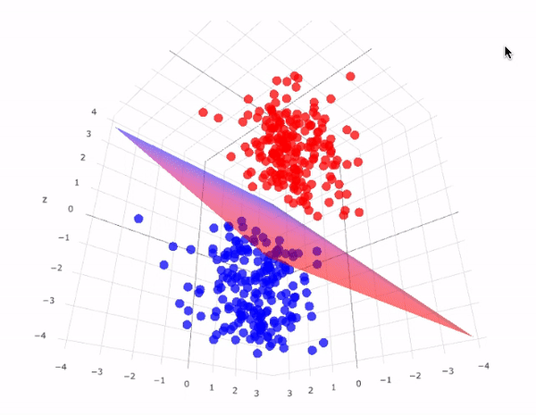
Introduction
Support Vector Machines (SVMs) are supervised learning methods used for classification and regression.
The purpose of SVM is to separate the data points by computing a hyperplane or a decision function.
The working procedure of SVM classification consists of two stages i.e. training phase and testing phase.
[1] Heena Farooq Bhat, MAW, (2013) Modified One-Against-All Algorithm Based on Support Vector Machine. International Journal of Advanced Research in Computer Science and Engineering (IJARCSSE).

Slide 3
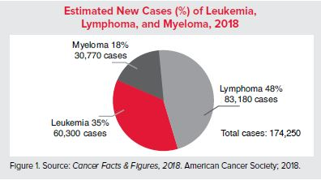
Facts and Statistic
New Cases
Approximately every 3 minutes one person in the United States (US) is diagnosed with a blood cancer.
An estimated combined total of 174,250 people in the US are expected to be diagnosed with leukemia, lymphoma or myeloma in 2018.
New cases of leukemia, lymphoma and myeloma are expected to account for 10 percent of the estimated 1,735,350 new cancer cases diagnosed in the US in 2018.
Prevalence
Prevalence is the estimated number of people alive on a certain date in a population who previously had a diagnosis of the disease. An estimated 1,345,123 people in the US are either living with, or are in remission from, leukemia, lymphoma or myeloma.
[2] Anonymous. “Facts and Statistics.” Leukemia and Lymphoma Society, 3 Mar. 2015, www.lls.org/http%3A/llsorg.prod.acquia-sites.com/facts-and-statistics/facts-and-statistics-overview/facts-and-statistics.

Slide 4
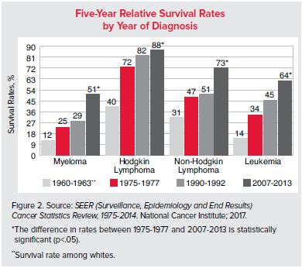
Facts and Statistic
Survival
Relative survival compares the survival rate of a person diagnosed with a disease to that of a person without the disease. The most recent survival data available may not fully represent the outcomes of all current therapies and, as a result, may underestimate survival to a small degree.
Deaths
Approximately every 9 minutes, someone in the US dies from a blood cancer. This statistic represents approximately160 people each day or more than 6 people every hour.
Leukemia, lymphoma and myeloma are expected to cause the deaths of an estimated 58,100 people in the US in 2018.
These diseases are expected to account for 9.5 percent of the deaths from cancer in 2018, based on the estimated total of 609,640 cancer deaths.
[2] Anonymous. “Facts and Statistics.” Leukemia and Lymphoma Society, 3 Mar. 2015, www.lls.org/http%3A/llsorg.prod.acquia-sites.com/facts-and-statistics/facts-and-statistics-overview/facts-and-statistics.

Slide 5
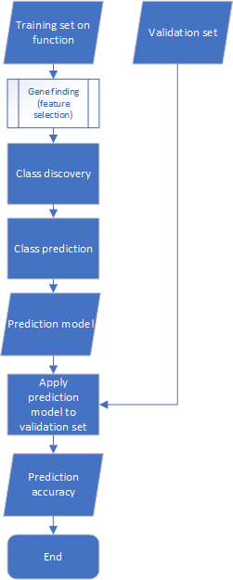
FS Algorithm
SVM – RFE, SVM – CGH, SVM – SFS, and SVM - MSFS
ISIS
Weighted kernel width and Gene expression colon scheme
[1] Heena Farooq Bhat, MAW, (2013) Modified One-Against-All Algorithm Based on Support Vector Machine. International Journal of Advanced Research in Computer Science and Engineering (IJARCSSE).

Slide 6
The Dataset
The leukemia data set contains expression levels of 7128 genes taken over 72 samples. Labels indicate which of two variants of leukemia is present in the sample.
Name of datasets | No. of features | No. of samples | No. of classes | Training Set | Test Set | Description
Leukemia data set | 7128 | 72 | 2 | 38 | 34 | 47 ALL, 25 AML
[4] Heena Farooq Bhat, (2017) Evaluating SVM algorithm for Bioinformatics Gene Expression Analysis. International Journal of Computer Science Engineering (IJCSE).

Slide 7
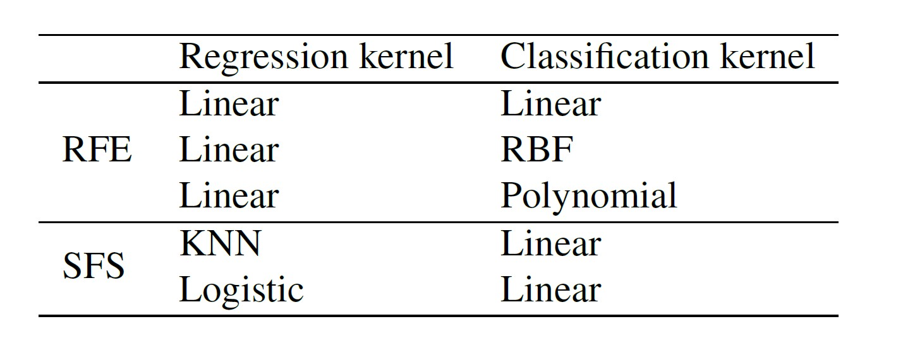
Methods

Slide 8
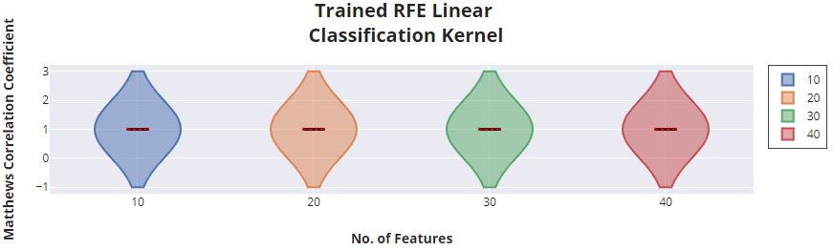
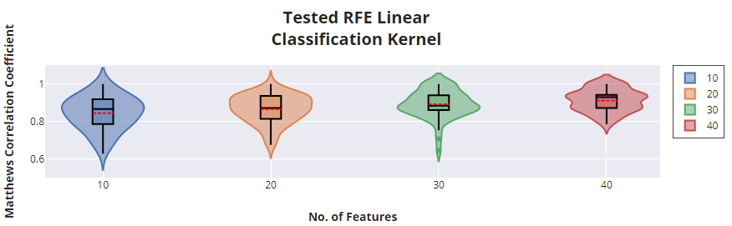
Experimental Results

Slide 9
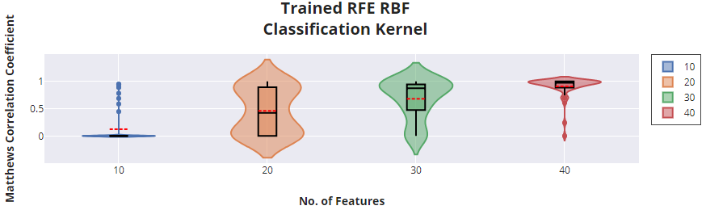
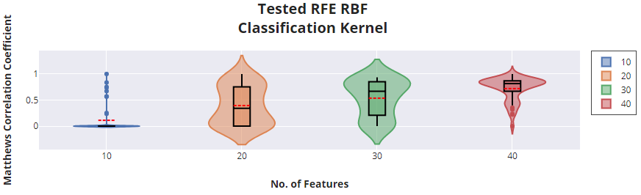
Experimental Results

Slide 10
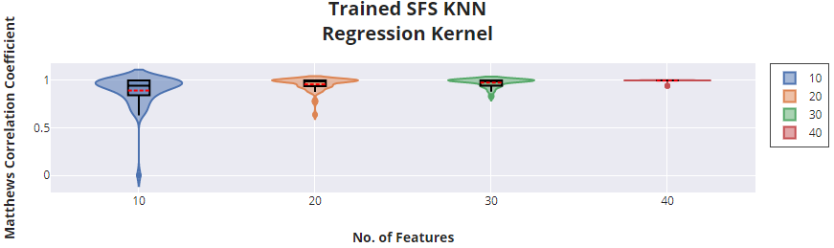
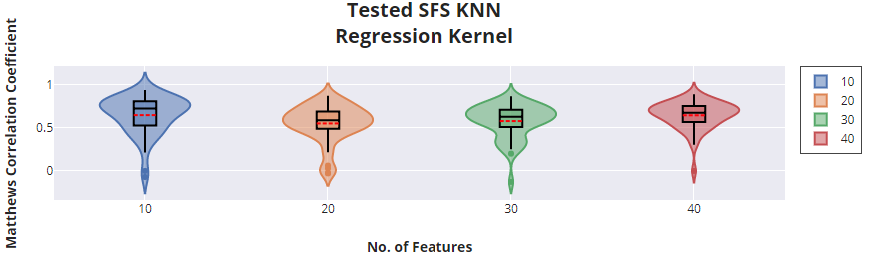
Experimental Results

Slide 11
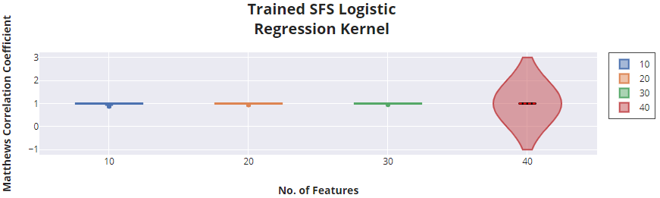
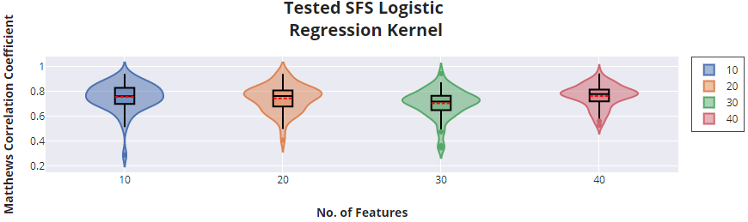
Experimental Results

Slide 12
Experimental Results
No. of Features | RFE Linear Classification Kernel |  | RFE RBF Classification Kernel |  | SFS KNN Regression Kernel |  | SFS Logistic Regression Kernel
 | Average | Max | Average | Max | Average | Max | Average | Max
10 | 84.48% | 100% | 11.25% | 100% | 64.85% | 94% | 93.69% | 94.10%
20 | 86.65% | 100% | 39.48% | 100% | 55.18% | 87.30% | 74.40% | 94%
30 | 89.24% | 100% | 53.63% | 93.7% | 57.92% | 86.70% | 70.48% | 94.30%
40 | 91.20% | 100% | 71.94% | 100% | 64.65% | 89.10% | 70.48% | 94.40%

Slide 13
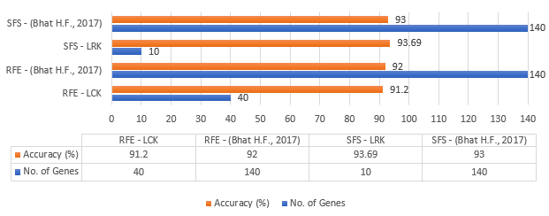
Results Comparison

Slide 14


